Slide 1

MACHINE LEARNING REGRESSION
BIAS VARIANCE TRADE-OFF

Slide 2
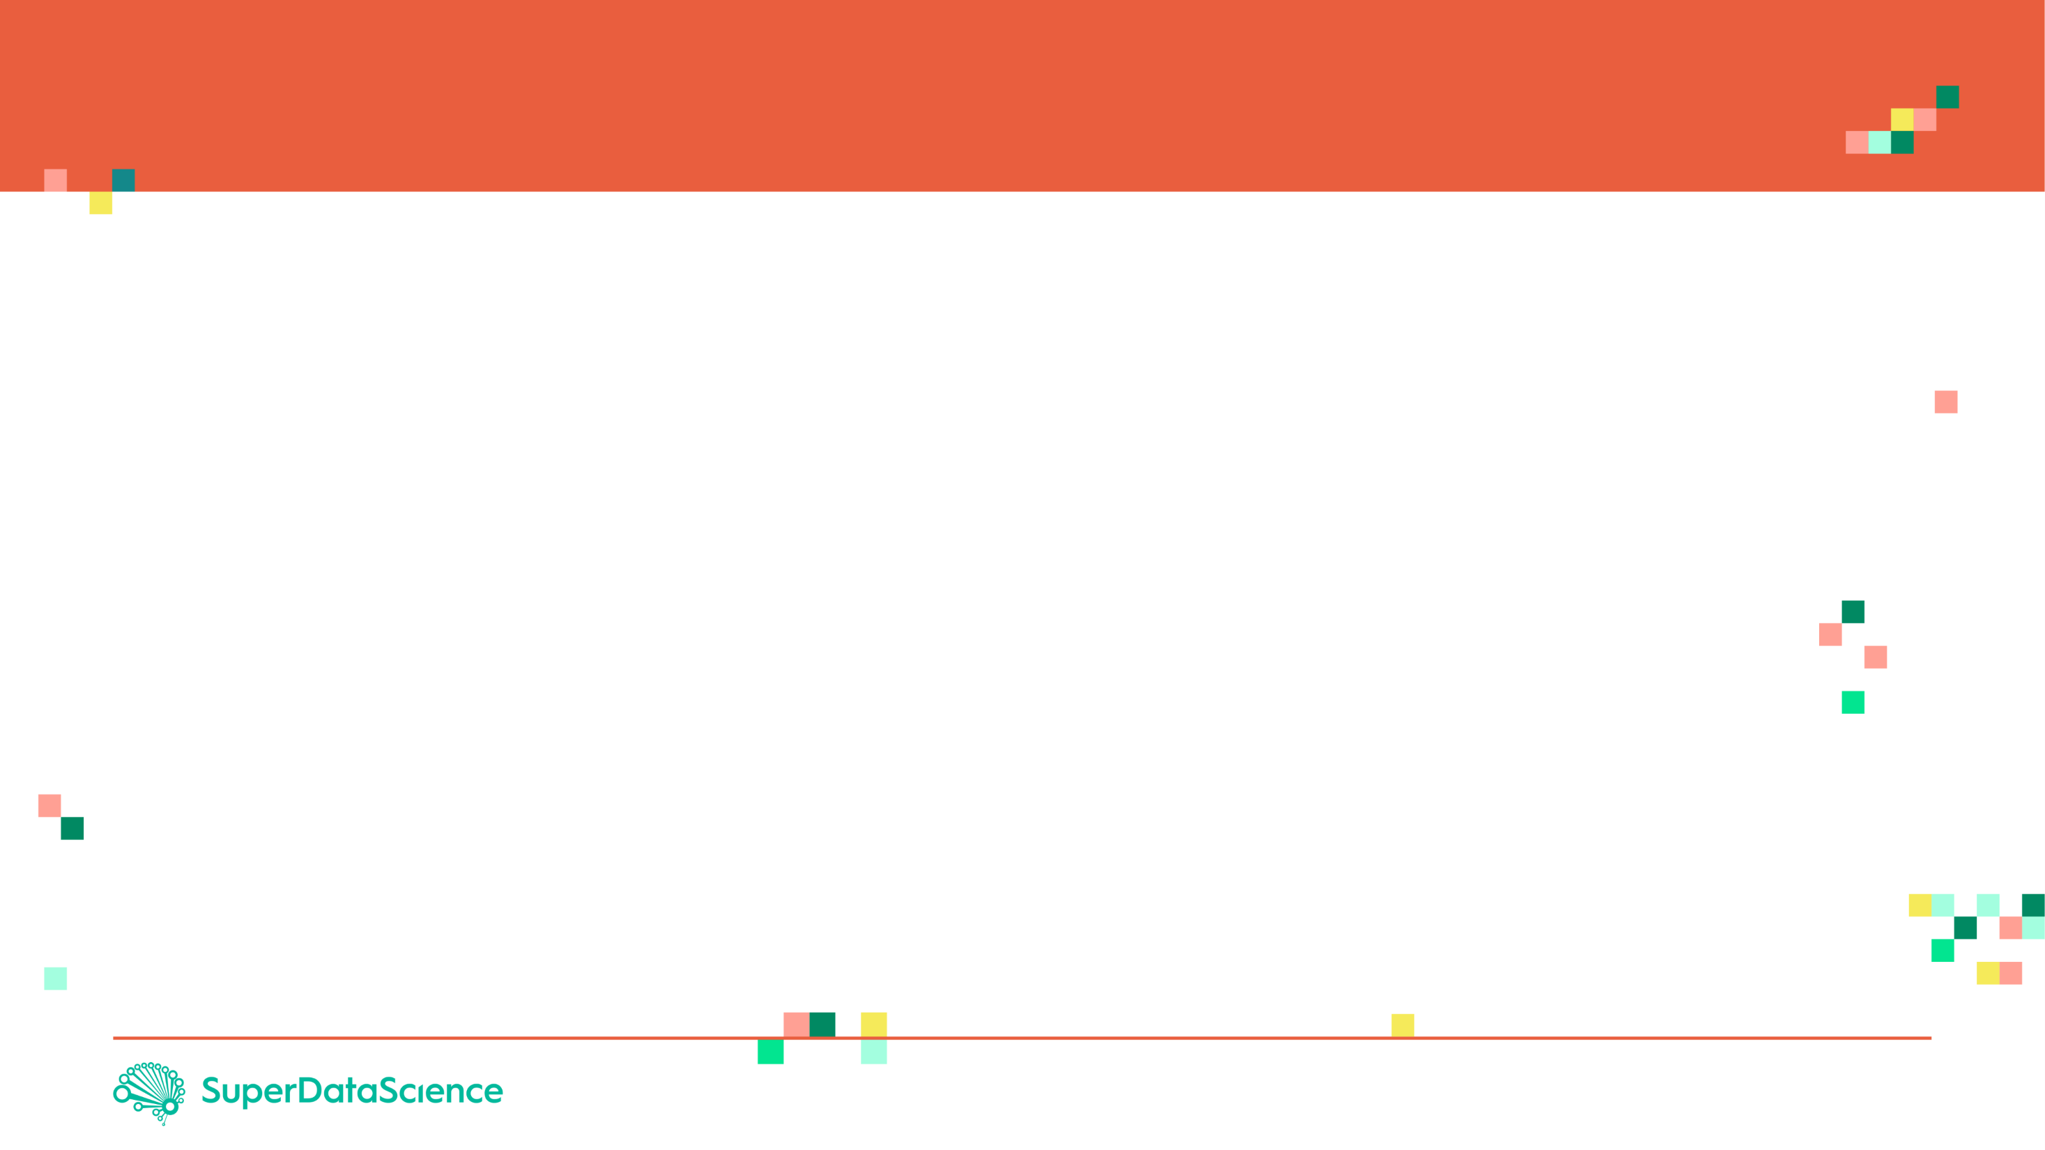
BIAS AND VARIANCE: INTUITION
Let’s assume that we want to get the relationship between the employee salary and number of years of experience
Fresh graduates tend to have low salaries
As years of experience increase, the salaries tend to increase as well.
As number of years go beyond a certain limit, salaries tend to plateau and they do not increase anymore
PERFECT (TRUE) MODEL!
SALARY
# YEARS OF EXPERIENCE

Slide 3
BIAS AND VARIANCE: TRAINING VS. TESTING DATASETS
Dataset is divided to training and testing datasets
Testing datasets have never been seen by the model before
SALARY
TESTING DATASET
TRAINING DATASET
# YEARS OF EXPERIENCE

Slide 4
BIAS AND VARIANCE: MODEL #1– LINEAR REGRESSION (SIMPLE)
Linear Regression model uses a straight line to fit the training dataset
Linear regression model lacks flexibility so it cannot properly fit the data (as the true perfect model does!)
The linear model has a large “bias” which indicates that the model is unable to accurately capture the true relationship between salary and # years of experience.
PERFECT (TRUE) MODEL!
SALARY
LINEAR REGRESSION MODEL
TRAINING DATASET
# YEARS OF EXPERIENCE

Slide 5
BIAS AND VARIANCE: MODEL #2 – HIGH ORDER POLYNOMIAL REGRESSION (COMPLEX)
PERFECT (TRUE) MODEL!
High order polynomial model is able to have a very small bias and can perfectly fit the training dataset.
High-order polynomial model is very flexible
SALARY
HIGH ORDER POLYNOMIAL MODEL
TRAINING DATASET
# YEARS OF EXPERIENCE

Slide 6


BIAS AND VARIANCE: MODEL #1 Vs. MODEL #2 DURING TRAINING
PERFECT (TRUE) MODEL!
PERFECT (TRUE) MODEL!
SALARY
SALARY
LINEAR REGRESSION MODEL
HIGH ORDER POLYNOMIAL MODEL
# YEARS OF EXPERIENCE
# YEARS OF EXPERIENCE
SUM OF SQUARES (LARGE)
SUM OF SQUARES (SMALL ~0)
THIS IS NOT THE WHOLE STORY!!

Slide 7
BIAS AND VARIANCE: MODEL #1 Vs. MODEL #2 DURING TESTING
PERFECT (TRUE) MODEL!
PERFECT (TRUE) MODEL!
SALARY
SALARY
LINEAR REGRESSION MODEL
HIGH ORDER POLYNOMIAL MODEL
# YEARS OF EXPERIENCE
# YEARS OF EXPERIENCE
SUM OF SQUARES (SMALL)
SUM OF SQUARES (LARGE)
The polynomial model performs poorly on the testing dataset and therefore it has large variance

Slide 8
MODEL COMPLEXITY VS. ERROR
OPTIMUM MODEL
Regularization works by reducing the variance at the cost of adding some bias to the model.
A trade-off between variance and bias occurs
TOTAL ERROR
VARIANCE
ERROR
BIAS
MODEL COMPLEXITY
LINEAR
POLYNOMIAL

Slide 9
MODEL COMPLEXITY VS. ERROR
MODEL #1 (LINEAR REGRESSION) (SIMPLE) | MODEL #2 (HIGH ORDER POLYNOMIAL) (COMPLEX)
Model has High bias because it is very rigid (not flexible) and cannot fit the training dataset well | Model has small bias because it is flexible and can fit the training dataset very well.
Has small variance (variability) because it can fit the training data and the testing data with similar level (the model is able to generalize better) and avoids overfitting | Has large variance (variability) because the model over fitted the training dataset and it performs poorly on the testing dataset
Performance is consistent between the training dataset and the testing dataset | Performance varies greatly between the training dataset and the testing dataset (high variability)
Good generalization | Over fitted
Variance measures the difference in fits between the training dataset and the testing dataset
If the model generalizes better, the model has small variance which means the model performance is consistent among the training and testing datasets
If the model over fits the training dataset, the model has large variance
PERFECT REGRESSION MODEL SHALL HAVE SMALL BIAS AND SMALL VARIABILITY!
A TRADEOFF BETWEEN THE BIAS AND VARIANCE SHALL BE PERFORMED FOR ULTIMATE RESULTS

